Slide 1

Knowledge Representation
Artificial Intelligence
Faculty of Computing
Universiti Teknologi Malaysia

Slide 2
Outline
We will learn these topics:
AI-based knowledge representation
Propositional Logic
Predicate Logic
Notes:
Application : Example by using text processing, text mining, image processing, natural language processing, speech recognition, video.

Slide 3
2.1 AI-based knowledge representation

Slide 4
Representation
AI agents deal with knowledge (data)
Facts (believe & observe knowledge)
Procedures (how to knowledge)
Meaning (relate & define knowledge)
Right representation is crucial
Early realisation in AI
Wrong choice can lead to project failure
Active research area

Slide 5
Choosing a Representation
For certain problem solving techniques
‘Best’ representation already known
Often a requirement of the technique
Or a requirement of the programming language (e.g. Prolog)
Examples
First order theorem proving… first order logic
Inductive logic programming… logic programs
Neural networks learning… neural networks
Some general representation schemes
Suitable for many different (and new) AI applications

Slide 6
Some General Representations
Logical Representations
Production Rules
Semantic Networks
Conceptual graphs, frames

Slide 7
Syntax and Semantics
Syntax
Rules for constructing legal sentences in the logic
Which symbols we can use (English: letters, punctuation)
How we are allowed to combine symbols
Semantics
How we interpret (read) sentences in the logic
Assigns a meaning to each sentence
Example: “All lecturers are seven foot tall”
A valid sentence (syntax)
And we can understand the meaning (semantics)
This sentence happens to be false (there is a counterexample)

Slide 8
Activity 2.1
Activity
Watch the video below.
Answer YES/NO for sentences given.
One student is called to discuss the answer.
Question
My book is crying.
Syntax : …………..
Semantic : …………..
UTM in Johore.
Syntax : …………..
Semantic : …………..
https://www.youtube.com/watch?v=zdoIfEKw3eU

Slide 9
Activity 2.1 - Answer
Explanation
Syntax is usually associated with the rules or grammar
Semantic is concerned with its meaning.
Question
My book is crying.
Syntax : YES
Semantic : NO
2. UTM in Johore.
Syntax : NO
Semantic : YES

Slide 10
But.. what is knowledge?
Rules?
Production systems
Classification?
Semantic networks
Structure?
Frames
Idealised and formalised knowledge?
Logic

Slide 11
Why need representation?
-capture important features of a problem
-make information accessible to problem solving procedure
-abstraction
e.g.
The real number: π
Decimal : 3.1415927….
Floating point : 31416 1
mantissa exponent
Computer memory: 11100010

Slide 12
AI as representation
A representational scheme should:
Be adequate to express all of the necessary information
Support efficient execution of the resulting code
Provide a natural scheme for expressing the required knowledge

Slide 13
AI as representation
To support all these needs, AI representation language must:
Handle qualitative knowledge-(reasoning) spatial
c
a b
clear(c),clear(a), ontable(a), ontable(b)
on(c,b), cube(a), cube(b), pyramid(c)
Predicates : clear, ontable, on, cube, pyramid

Slide 14
AI as representation
2. Allow new knowledge to be inferred from set of facts and rules
∀ X ¬ ∃Y on(X,Y) 🡺 clear (X)
3. Allow representation of general principles as well as specific solutions
4. Capture complex semantic meaning
hassize(bluebird, small), hascovering(bird,feathers), hascolor(bluebird,blue), hasproperty(bird,flies)
5. Allow for meta-level reasoning
“knowing about what you know” – meta-knowledge
-for all X, X is clear if there does not exist a Y such that Y is on X-

Slide 15
AI as representation
Knowledge representation languages:
Predicate calculus, semantic networks, frames, objects, rules,..etc.

Slide 16
2.2 Propositional Logic

Slide 17
What is a Logic?
A language with concrete rules
No ambiguity in representation (may be other errors!)
Allows unambiguous communication and processing
Very unlike natural languages e.g. English
Many ways to translate between languages
A statement can be represented in different logics
And perhaps differently in same logic
Expressiveness of a logic
How much can we say in this language?
Not to be confused with logical reasoning
Logics are languages, reasoning is a process (may use logic)

Slide 18
Ask google ..what is propositional logic?
propositional logic logic (or "propositional calculus")
A system of symbolic logic using symbols to stand for whole propositions and logical connectives.
Propositional logic only considers whether a proposition is true or false.
In contrast to predicate logic, it does not consider the internal structure of propositions.

Slide 19
Basic Logic Operations
The NOT operation: ¬
The AND operation: ∧
The OR operation: ∨
The “implication” operation: →
The “equivalence” operation: ↔ or ≡

Slide 20
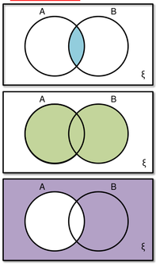
Activity 2.2
Activity
Form a group of two members. Discuss the right logic operation that is suitable for Venn diagram below.
Operation : …………..
Operation : …………..
Operation : …………..

Slide 21
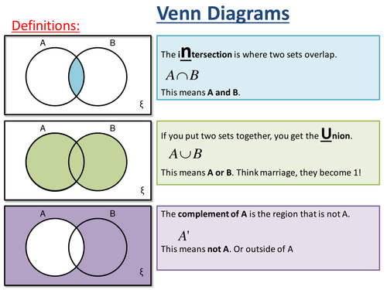
Activity 2.2 - Answer

Slide 22
Logic in General (1)
Logics are formal languages for representing information such that conclusions can be drawn
When people talk about logic they often mean propositional or first-order predicate logic.

Slide 23
Logic in General (2)
A logic usually has a well defined syntax, semantics and proof theory.
The syntax of a logic defines the syntactically acceptable objects of the logic, or well-formed formulae.
The semantics of a logic associate each formula with a meaning.
The proof theory is concerned with manipulating formulae according to certain rules.

Slide 24
Propositions???
Anwar Ibrahim is Prime Minister
What's the time?
2 + 3 = 5
‘Phone’ has five letters.
2 + 3 = 6
Oh dear!
‘Work’ has five letters.
the reactor is on
All elephants have 4 legs
I like AI class

Slide 25
Propositional Logic
The syntax of propositional logic is constructed from propositions and connectives.
A proposition is a statement that is either true or false but not both

Slide 26

Propositional Logic
Syntax
Propositions, e.g. “it is wet”
Connectives: and, or, not, implies, iff (equivalent)
Brackets, T (true) and F (false)
Semantics (Classical AKA Boolean)
Define how connectives affect truth
“P and Q” is true if and only if P is true and Q is true
Use truth tables to work out the truth of statements

Slide 27
How to determine Propositions??
It is possible to determine whether any given statement is a proposition by prefixing it with
It is true that . . .
and seeing whether the result makes grammatical sense.
Propositions are often abbreviated using propositional variables eg p, q, r.
Thus we must associate the propositional variable with its meaning i.e.
Let p be Anwar is Prime Minister.

Slide 28
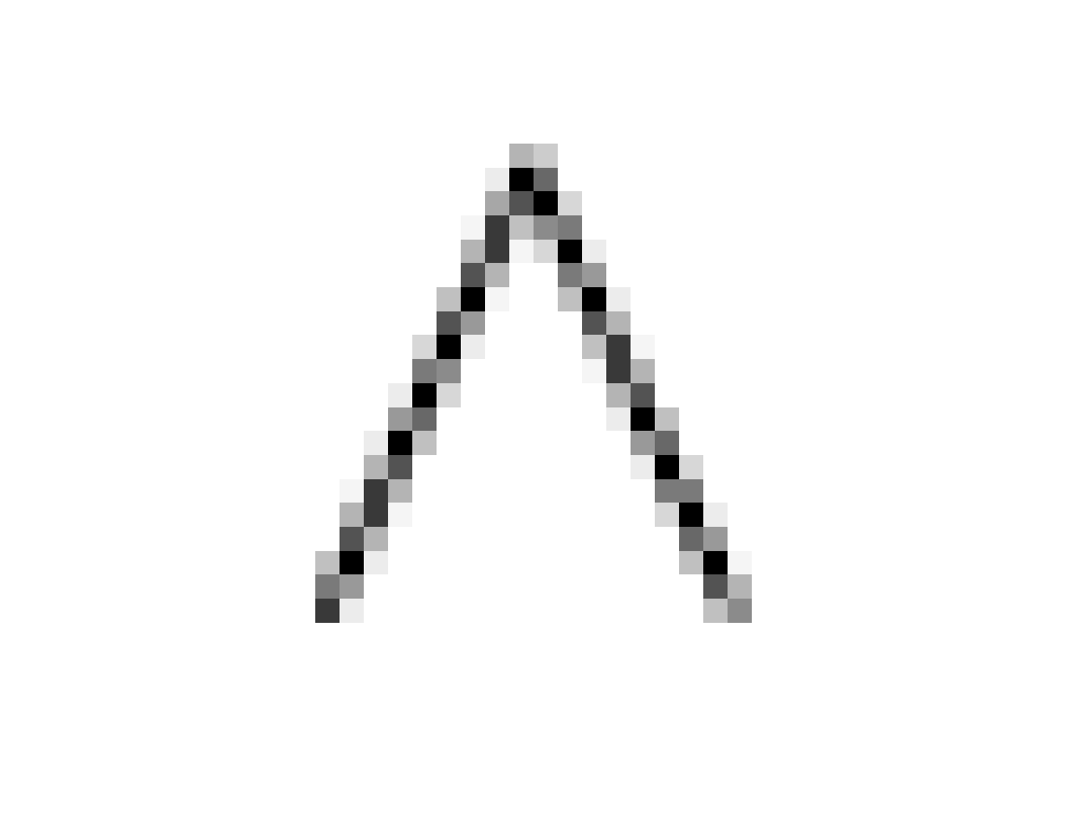
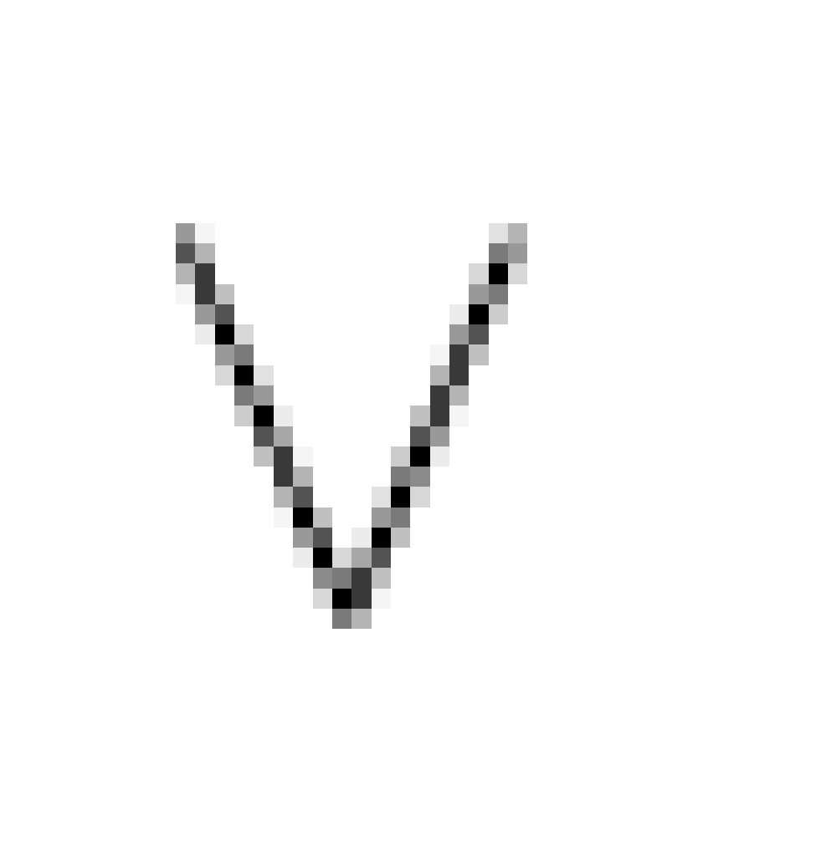
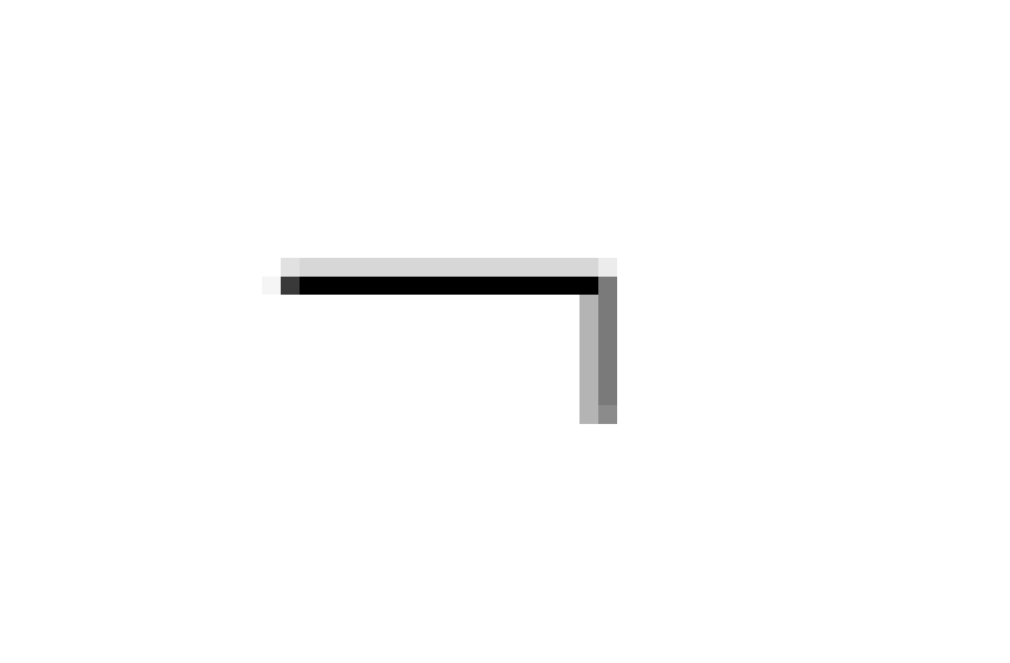
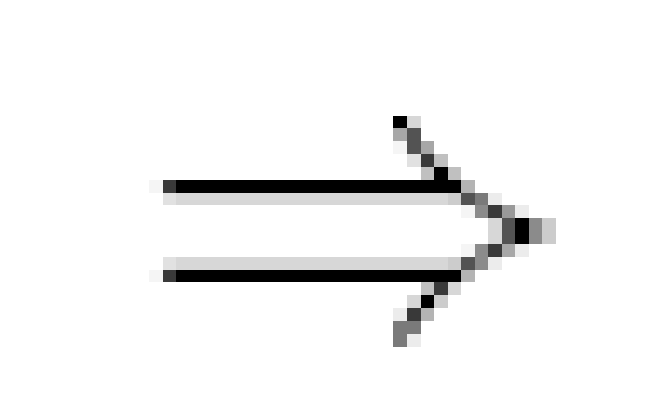

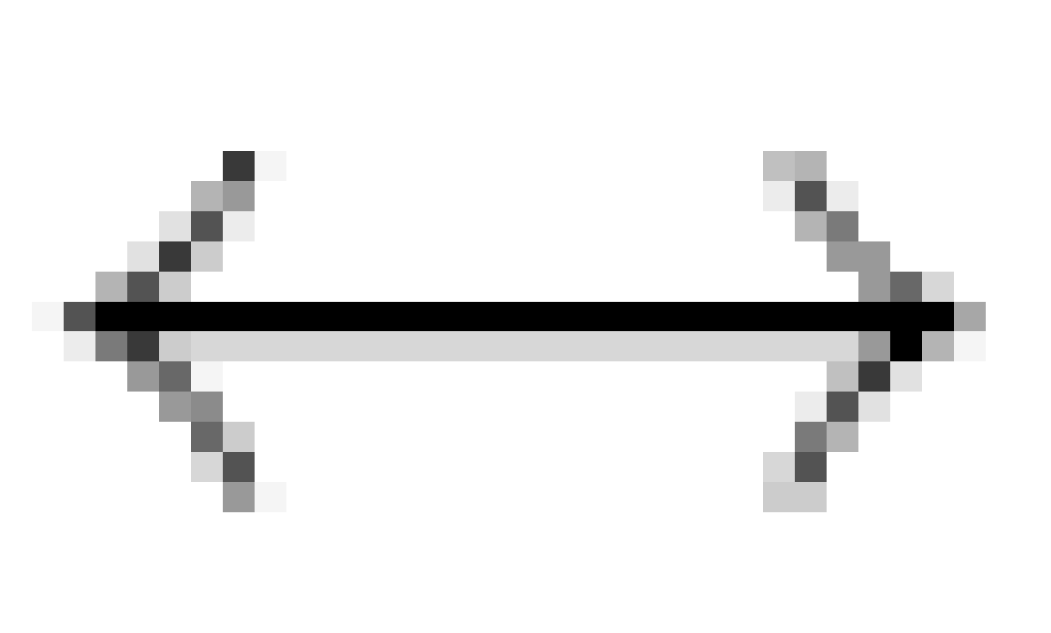

Connectives
Propositions may be combined with other propositions to form compound propositions. These in turn may be combined into further propositions.
The connectives that may be used are
and conjunction (& or .)
or disjunction (| or +)
not negation (~)
if . . .then implication ( )
if and only if equivalence ( )
Some books use different notations. Some of these are given in parentheses.

Slide 29


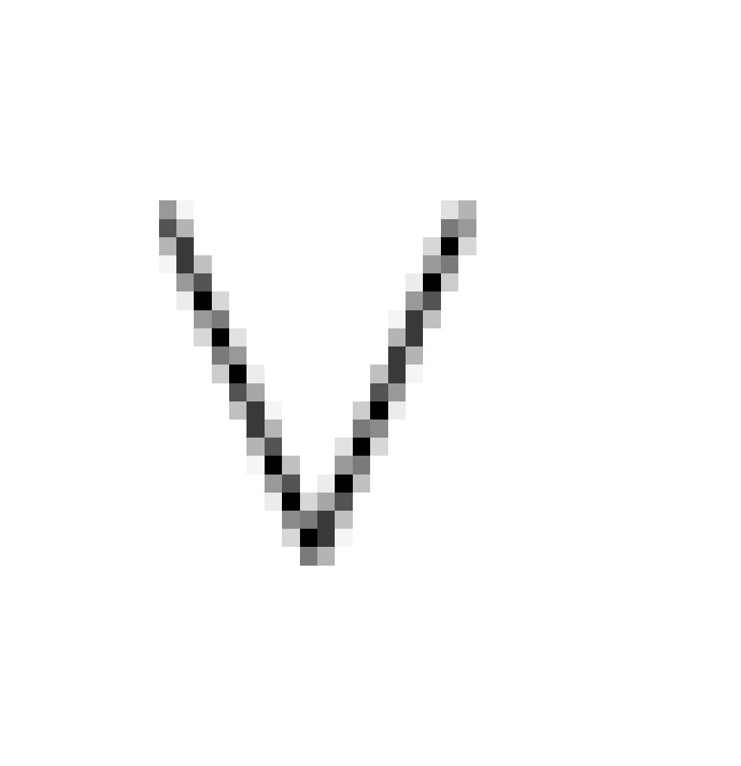
Propositional Logic: Syntax
The proposition symbols P1, P2 etc are sentences
If S is a sentence, S is a sentence (negation)
If S₁ and S₂ are sentences, S₁ S₂ is a sentence (conjunction)
If S₁ and S₂ are sentences, S₁ S₂ is a sentence (disjunction)
If S₁ and S₂ are sentences, S₁ S₂ is a sentence (implication)
If S₁ and S₂ are sentences, S₁ S₂ is a sentence (equivalence)

Slide 30
Propositional Logic: Semantic
Each model species true/false for each proposition symbol
E.g. P Q R
true true false
(With these symbols, 8 possible models, can be enumerated automatically.)
Rules for evaluating truth with respect to a model m are determined by truth tables
Why 8?

Slide 31
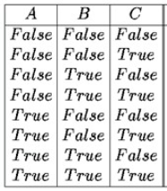
Propositional Logic: Semantic
Why 8 models?
P Q R
true true false
How many variables? 3 variables P, Q and R
How many models? 2³ = 8 models

Slide 32
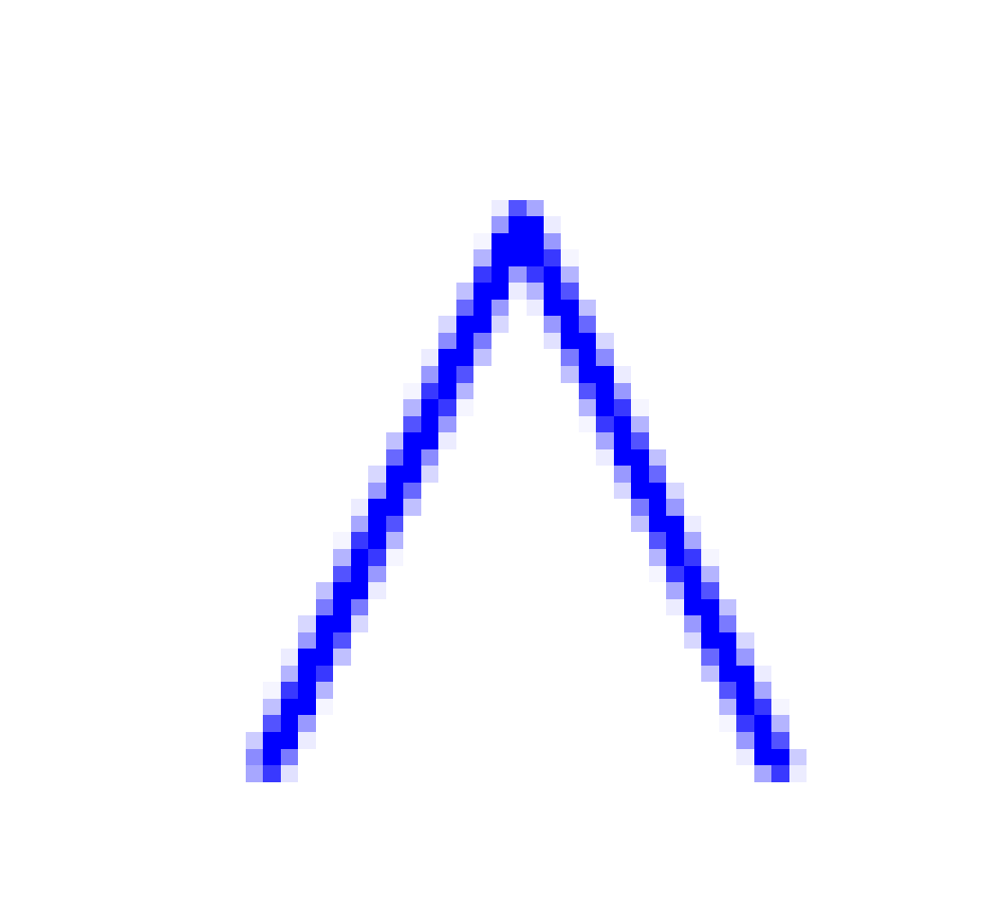
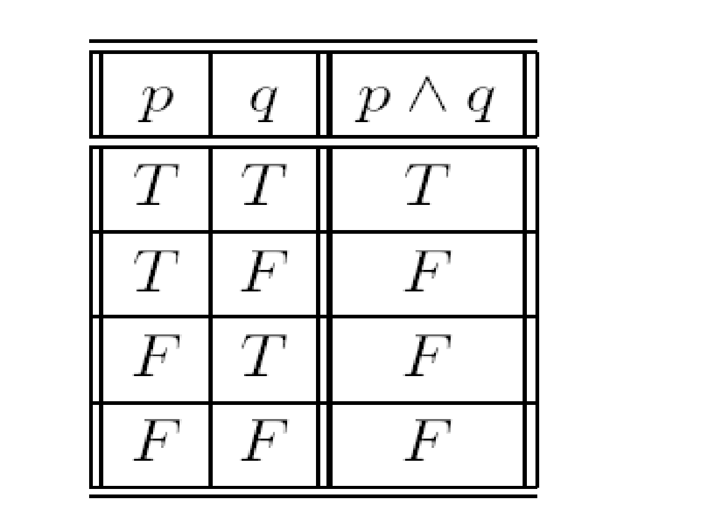
And (also called conjunction)
The conjunction ‘p AND q’, written p q, of two propositions is true when both p and q are true, false otherwise.
We can summarise the operation of using a Truth table. Rows in the table give all possible setting of the propositions to true (T) or false (F).
p | q

Slide 33
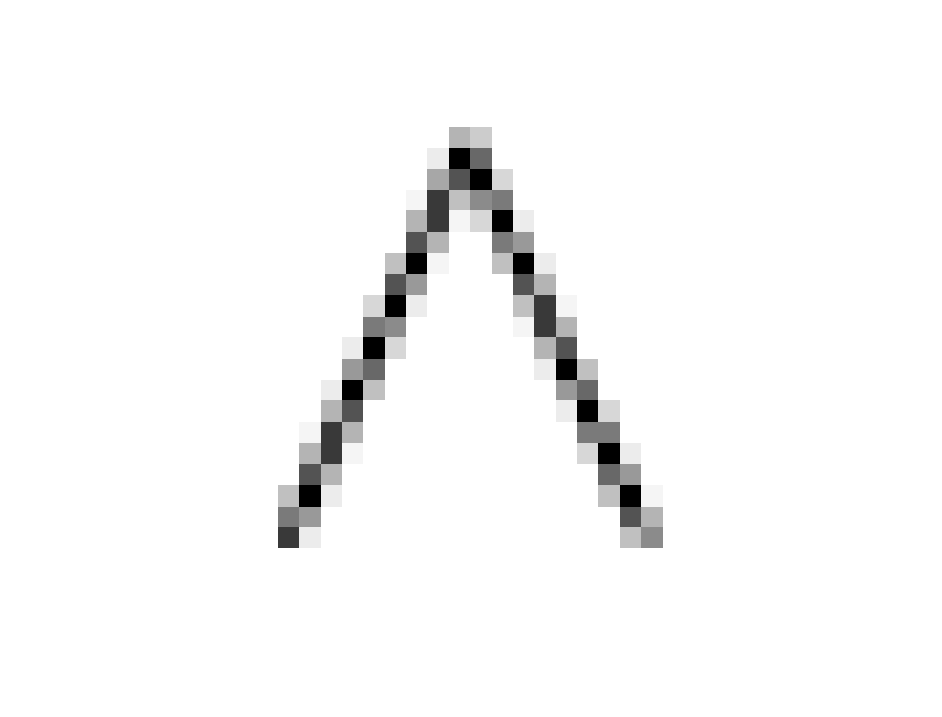
Natural Language Meaning (1)
p Its Monday.
q Its raining.
p q Its Monday and its raining.
Its Monday but its raining.
Its Monday. Its raining.

Slide 34
Natural Language Meaning (2)
Caution: semantics?
p I took a shower
q I woke up
p ^ q “I took a shower and I woke up”
q ^ p “I woke up and I took a shower”.
Logically the same! WE may see difference.
The word both is often useful eg. I both took a shower and I woke up.

Slide 35
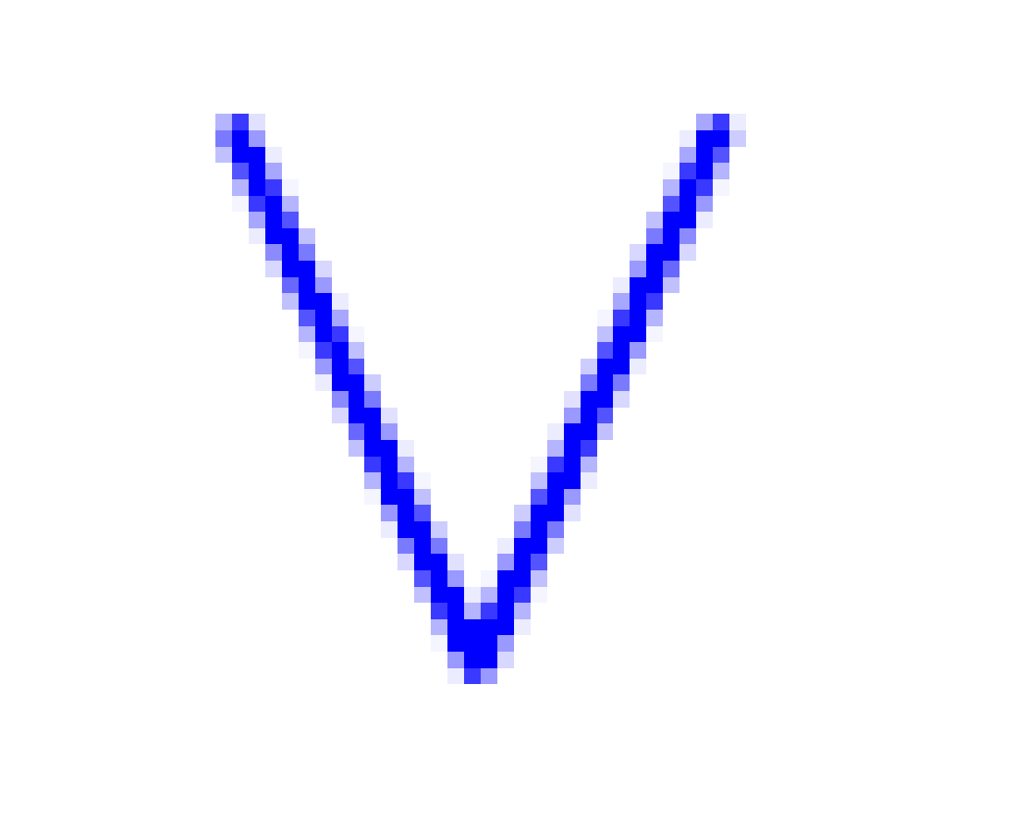

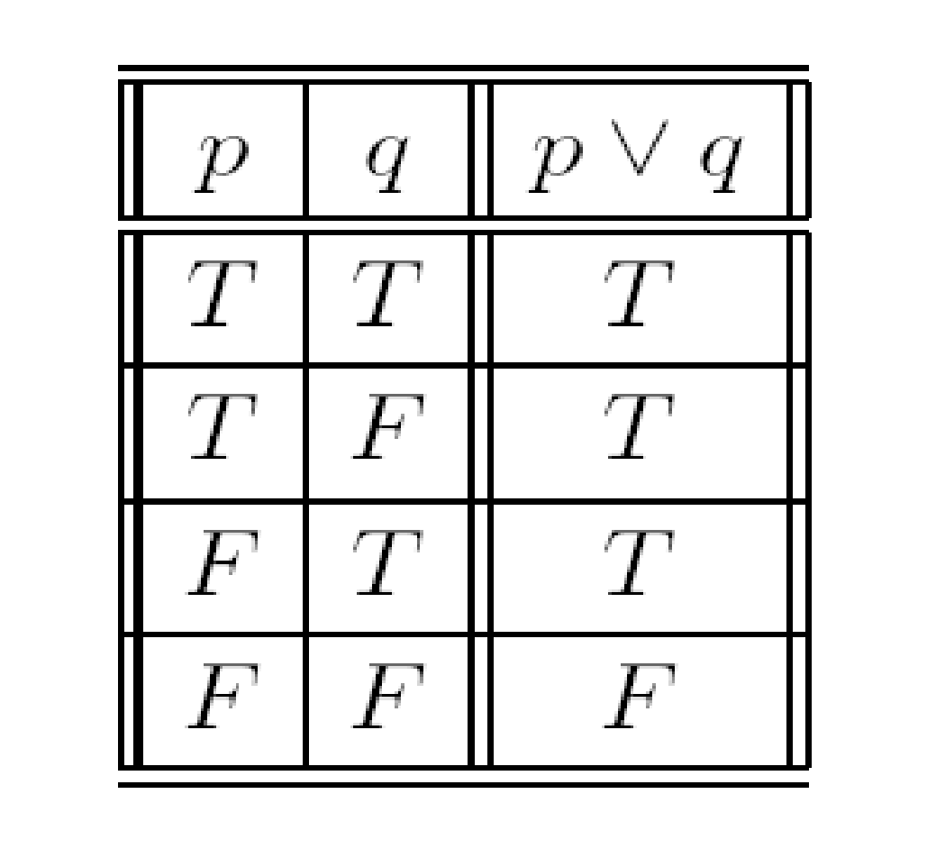
Or
Also called disjunction.
The disjunction ‘p OR q’, written p q, of two propositions is true when p or q (or both) are true, false otherwise.
Sometimes called inclusive or.
p | q

Slide 36

Natural Language Meaning
p It’s Monday.
q It’s raining.
p q It’s Monday or it is raining.
The word either is often useful eg. either it’s Monday or it is raining.
It also includes the case of rain on a Monday!

Slide 37



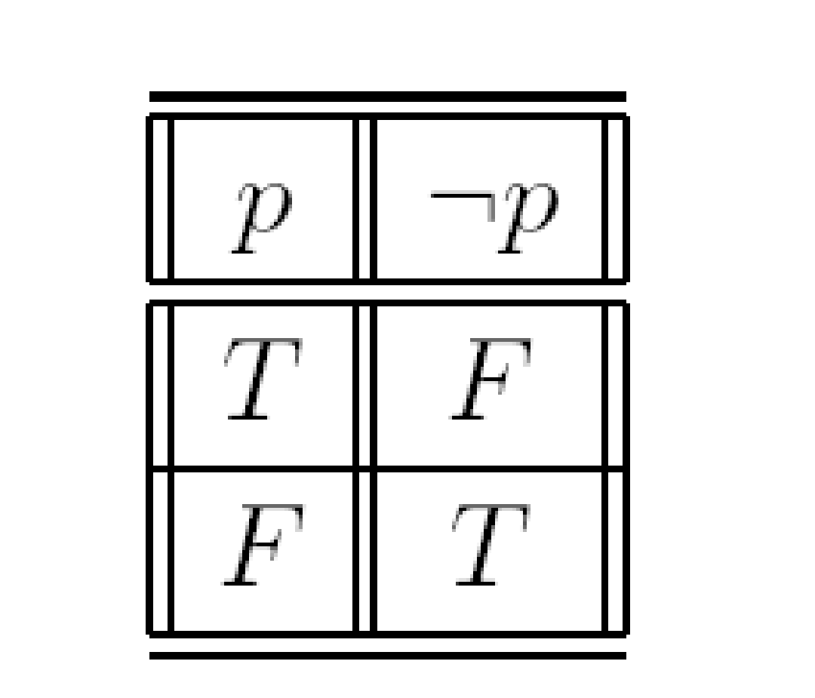
Not
Also known as negation
The negation ‘NOT p’ of a proposition (or p) is true when p is false and is false otherwise. p may be read that it is false that p.
Negation is a unary connective. It only takes one argument.
Conjunction and disjunction were both binary connectives.
p

Slide 38
Natural Language Meaning
p Logic is easy.
p It is false that logic is easy.
It is not the case that logic is easy.
Logic is not easy.

Slide 39
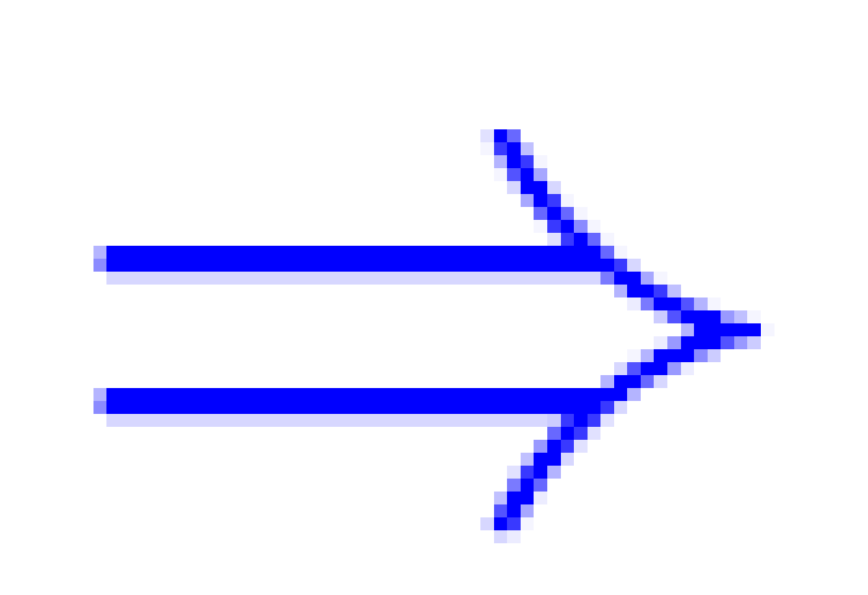
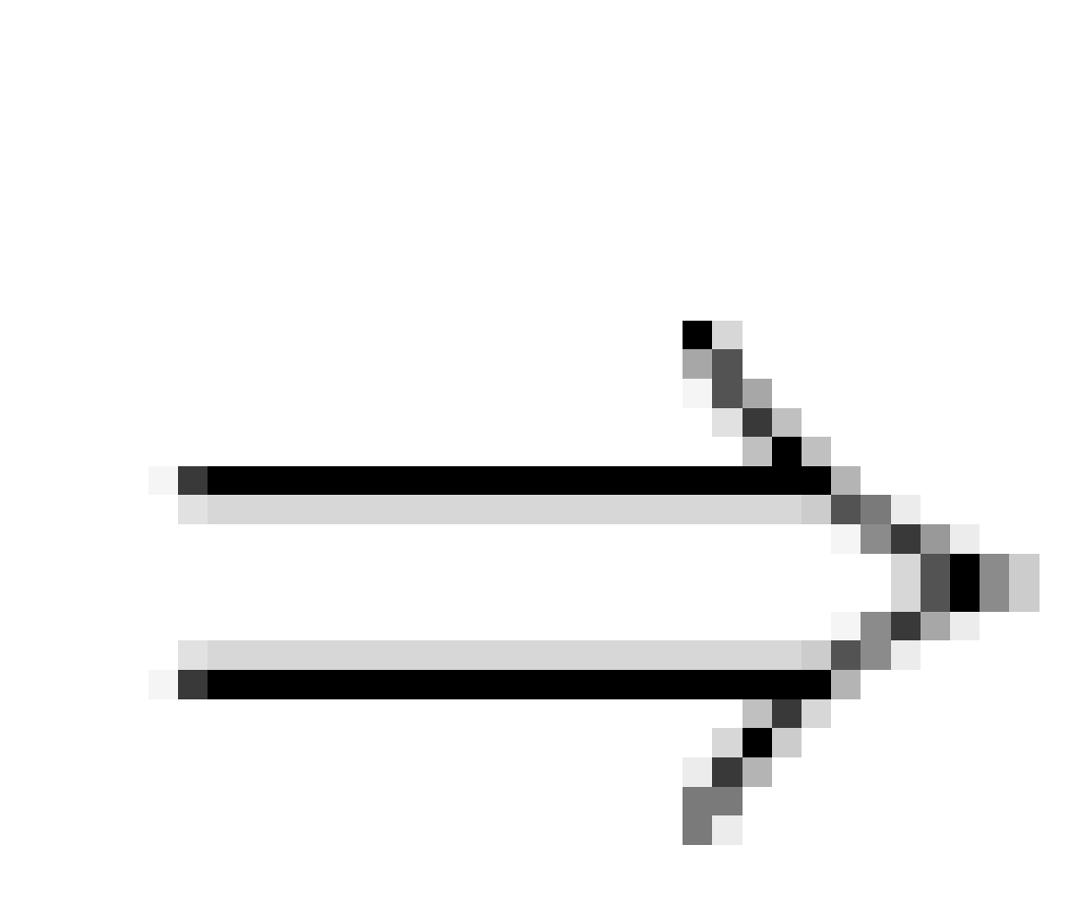
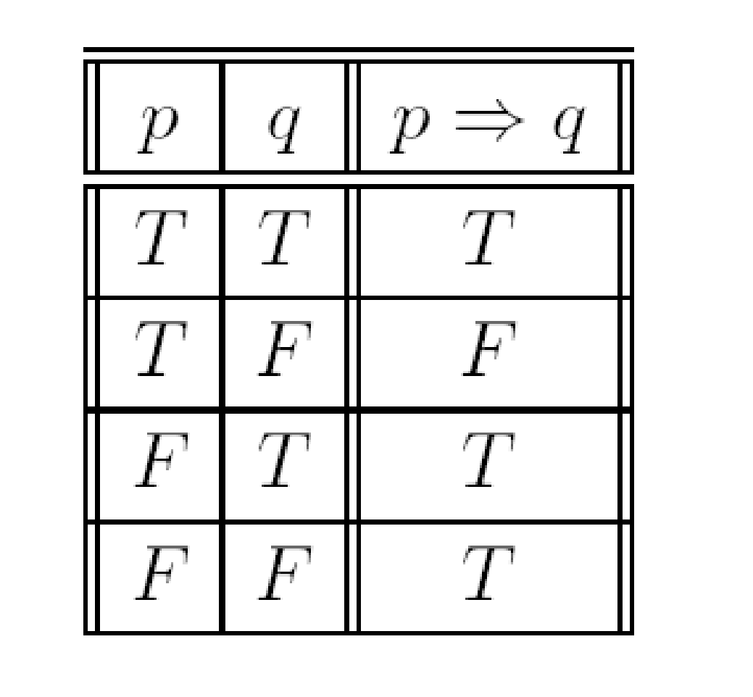
If . . . then . .
Also known as implication
The implication ‘p IMPLIES q’, written p q, of two propositions is true when either p is false or q is true, and false otherwise. An if…then statement will be false when p is true and q is false, and will be true for all other cases
p | q

Slide 40
Natural Language Meaning
p I study hard.
q I get rich.
p q If I study hard then I get rich.
Whenever I study hard, I get rich.
That I study hard implies I get rich.
I get rich, if I study hard.

Slide 41

More About Implication
p q is true in the following situations
I study hard and I get rich; or
I don't study hard and I get rich; or
I don't study hard and I don't get rich.
The last two situations, i.e. when p is false (I don't study hard) we can't say whether I will get rich or not. However if I've studied hard but failed to become rich then the proposition is clearly false.

Slide 42


Contrapositive
p q If I study hard then I get rich.
q p If I get rich then I study hard.
(the converse.)
q p If I don't get rich then I don't study hard.
(the contrapositive.)

Slide 43
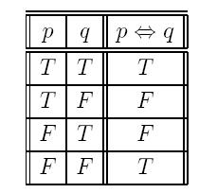
Biconditional
Also known as iff (if and only if) or the biconditional.
The biconditional, written as p q, of two propositions is true when both p and q are true or when both p and q are false, and false otherwise.

Slide 44
Biconditional
p A shape is a rectangle.
q A shape has four sides.
p q A shape is a rectangle if and only if it has four sides.

Slide 45
WFF
The set of sentences or well-formed propositional formulae (WFF) is defined as:
Any propositional symbol is in WFF.
The nullary connectives, true and false are in WFF.
If A and B are in WFF then so is ~A, A v B,
A ^ B, A⭢ B and A ⭤ B.
If A is in WFF then so is (A).

Slide 46
Example
The following are well formed formulae
whereas
are not.

Slide 47
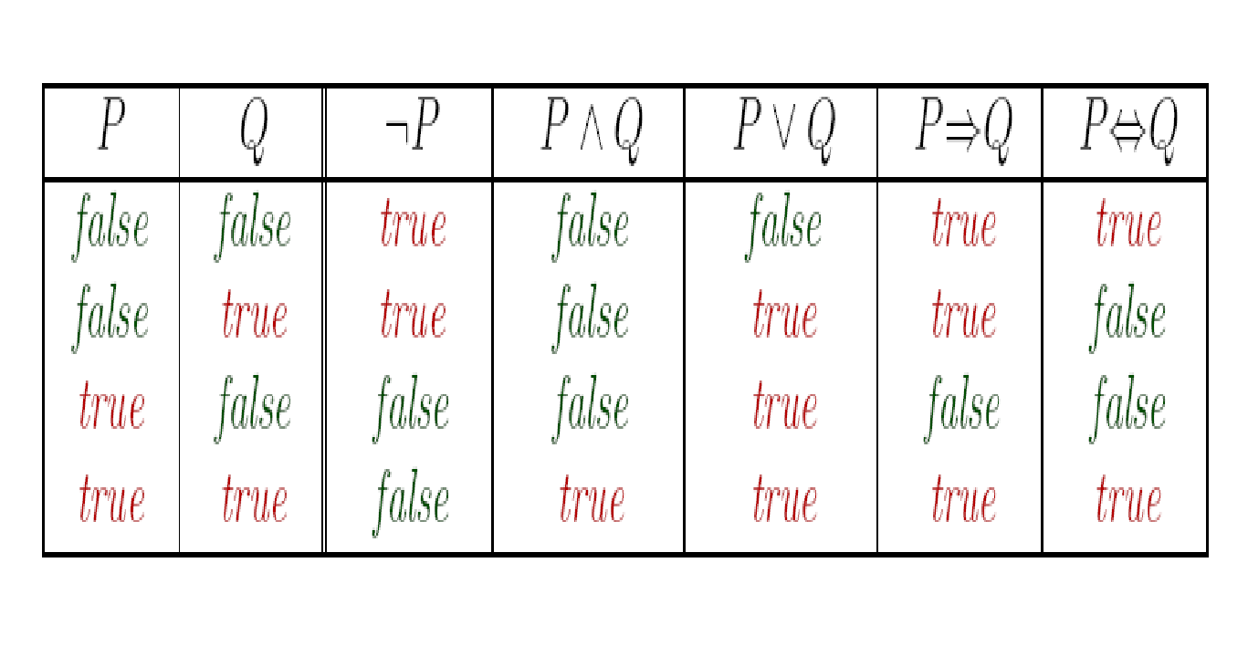
Recap: Truth Tables

Slide 48
Truth Tables for Compound Propositions
Truth tables may be used to show interpretations of compound propositions.
To draw up a truth table, construct a column for each proposition involved.
You need 2^{n} rows for n propositions for all possible ways of setting the propositions to T and F.
If we have 3 propositions, p; q; r, i.e. we need 2³ = 8 rows.
Next, construct a column for each connective, the most deeply nested first.
Evaluate each column using values for propositions or previous columns.

Slide 49
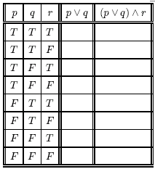

Quiz
p.. (my breakfast is) eggs.
q.. (my breakfast is) cereal.
r.. (my breakfast is) toast.
The statement ‘my breakfast is either eggs or cereal, and toast’ may be written in symbolic form as ???
WHAT DOES THE TABLE TELL U?

Slide 50
Quiz
Write this sentence in logic
my breakfast is either eggs or cereal, and toast
I want pizza A, maybe pizza B, but I also want pizza C. Which pizza combinations will make me happy?
Write a human sentence for this logic (p is eggs, q is cereal and r is toast)
(p AND q) OR r
(NOT p) OR q

Slide 51
... So
The truth table gives results for all possible interpretations of p, q and r. The compound proposition is true if
I eat cereal, eggs and toast; or
I eat cereal and toast; or
I eat eggs and toast.
Interpretation - A line in the truth table.

Slide 52

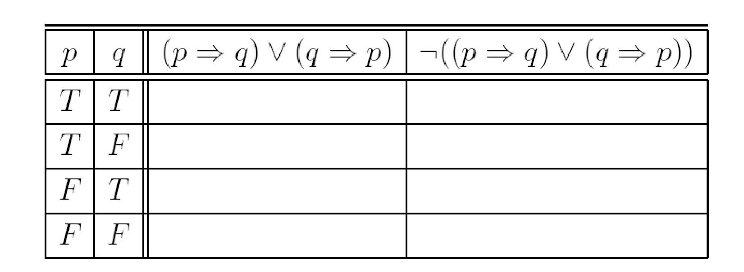


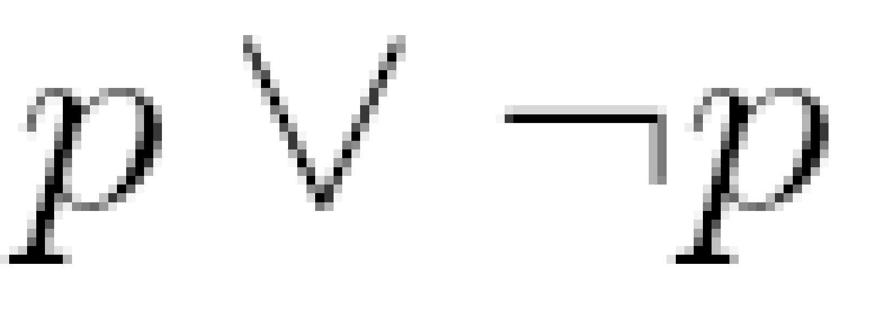
Try this..
Complete the truth table for
Show that the formula is satisfiable
Find an interpretation which satisfies
Show is valid.

Slide 53
2.3 Predicate Logic

Slide 54
Predicate Logic
Propositional logic combines atoms
An atom contains no propositional connectives
Have no structure (today_is_wet, john_likes_apples)
Predicates allow us to talk about objects
Properties: is_wet(today)
Relations: likes(john, apples)
True or false
In predicate logic each atom is a predicate
e.g. first order logic, higher-order logic

Slide 55
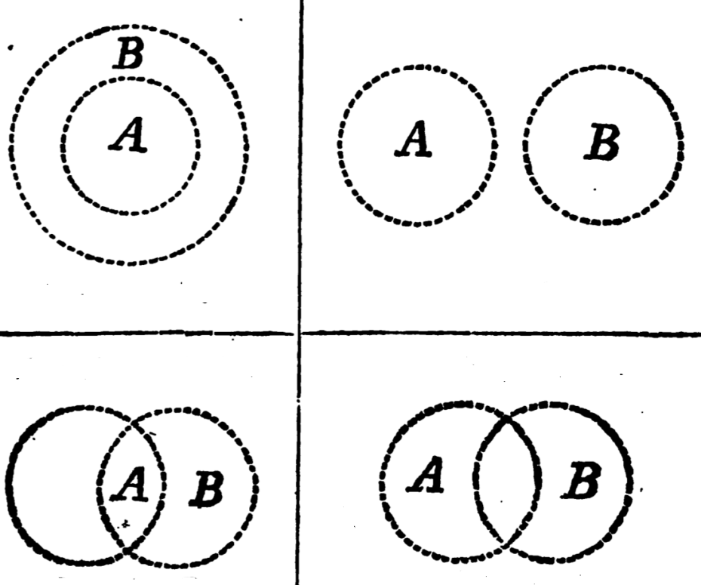
Activity 2.3
Activity
Form a group of two members. Discuss the right logic operation that is suitable for Venn diagram below.
Operation : …………..
Operation : …………..
Operation : …………..
Operation : …………..

Slide 56
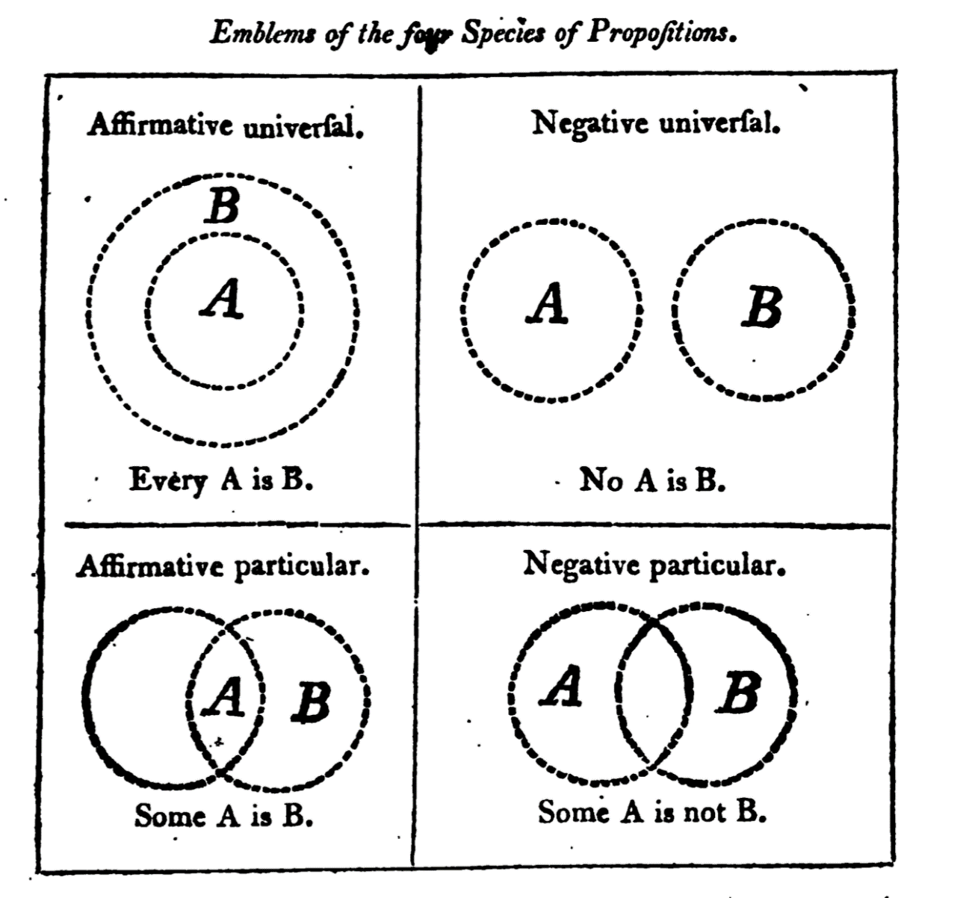
Activity 2.3 - Answer

Slide 57
Predicate Calculus (First Order Logic)
Constants are objects: john, apples
Predicates are properties and relations:
likes(john, apples)
Functions transform objects:
likes(john, fruit of(apple_tree))
Variables represent any object: likes(X, apples)
Quantifiers qualify values of variables
True for every objects (Universal): ∀X. likes(X, apples)
Exists at least one object (Existential): ∃X. likes(X, apples)

Slide 58
Example: FOL Sentence
“Every rose has a thorn”
For all X
if (X is a rose)
then there exists Y
(X has Y) and (Y is a thorn)

Slide 59
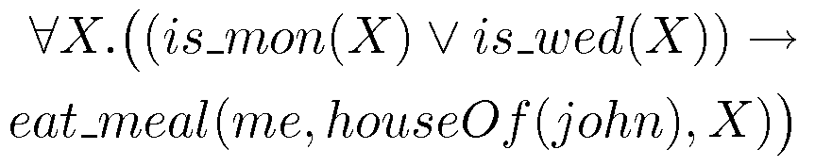
Example: FOL Sentence
“On Mondays and Wednesdays I go to John’s house for dinner”
Note the change from “and” to “or”
Translating is problematic

Slide 60
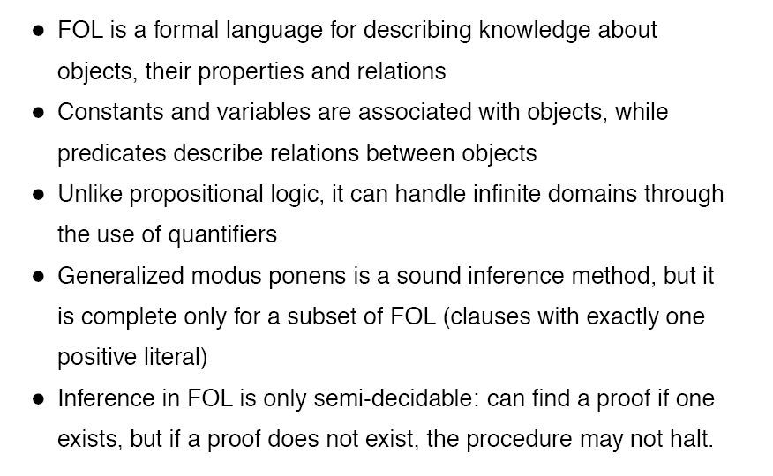
First-Order Logic (FOL)

Slide 61
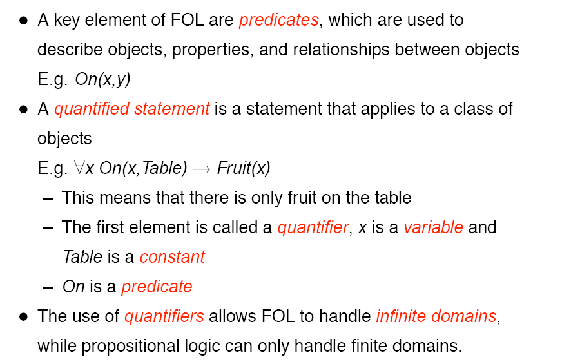
First-Order Logic (FOL)

Slide 62
First Order Predicate Calculus
Includes 2 symbols:
Variable quantifiers
∃ (existential) and
∀ (universal)
A quantifier followed by a variable and a sentence:
∀ X likes(X,pizza) ;true for all X
∃ Y friends(Y,amir) ;true if there is at least one

Slide 63
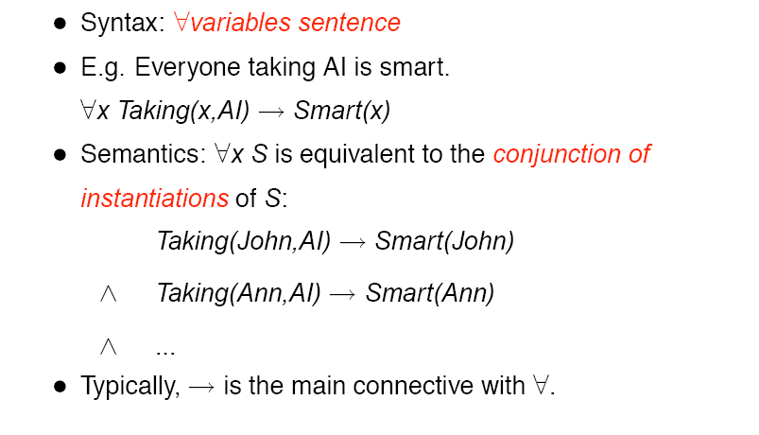
Universal Quantification
Conjunction means AND

Slide 64
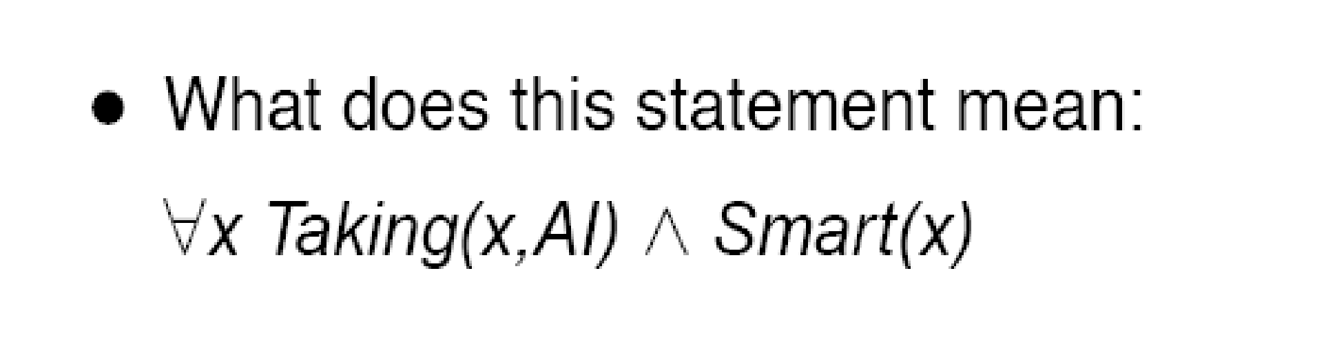
Example

Slide 65
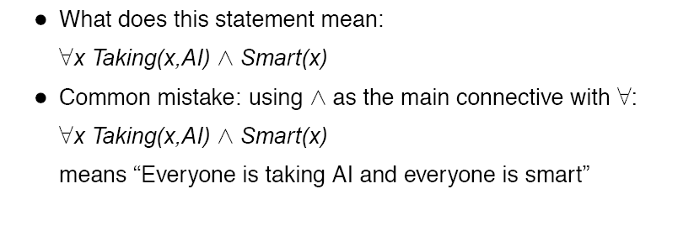
Example

Slide 66
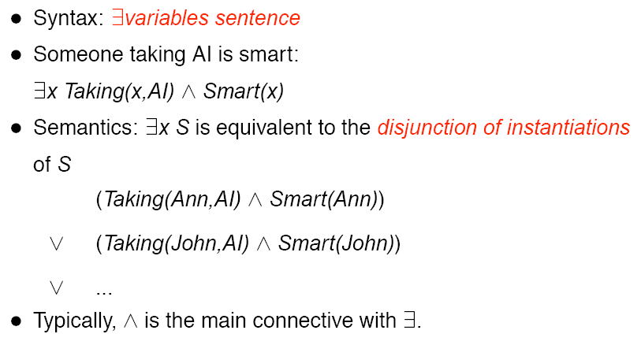
Existential Quantification
Disjunction means OR

Slide 67
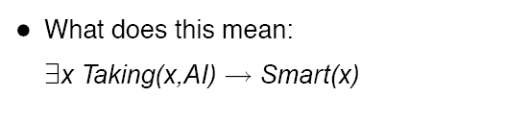
Example

Slide 68
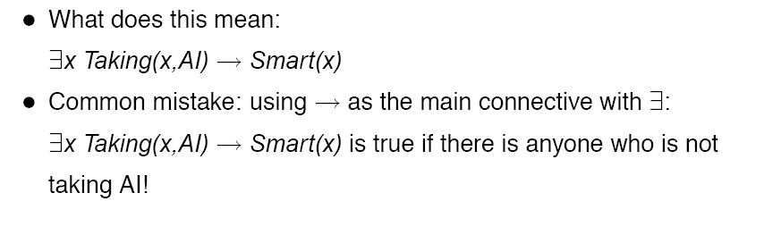
Example

Slide 69
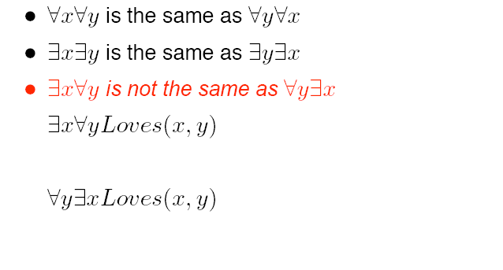
Properties of Quantifiers
????

Slide 70
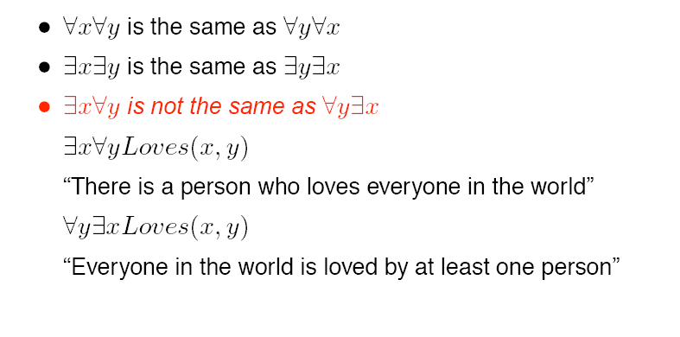
Properties of Quantifiers

Slide 71
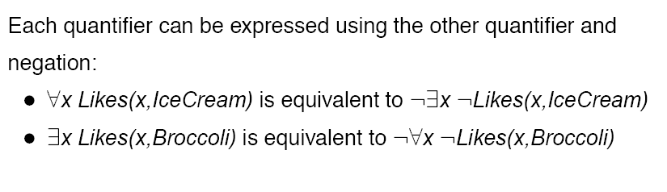
Quantifier Duality
Everyone likes ice cream == Not someone not liking ice cream
(nobody do not like ice cream)
Someone like broccoli == Not everyone not liking broccoli

Slide 72
How to read quantified formulas
When reading quantified formulas in English, read them from left to right. ∀x can be read as "for every object x in the universe the following holds" and ∃x can be read as "there exists an object x in the universe which satisfies the following" or "for some object x in the universe the following holds".
For example, let the universe be the set of airplanes and let F(x, y) denote "x flies faster than y". Then
∀x ∀y F(x, y) can be translated initially as "For every airplane x the following holds: x is faster than every (any) airplane y". In simpler English it means "Every airplane is faster than every airplane (including itself !)".
∀x ∃y F(x, y) can be read initially as "For every airplane x the following holds: for some airplane y, x is faster than y". In simpler English it means "Every airplane is faster than some airplane".
∃x ∀y F(x, y) represents "There exist an airplane x which satisfies the following: (or such that) for every airplane y, x is faster than y". In simpler English it says "There is an airplane which is faster than every airplane" or "Some airplane is faster than every airplane".
∃x ∃y F(x, y) reads "For some airplane x there exists an airplane y such that x is faster than y", which means "Some airplane is faster than some airplane".

Slide 73
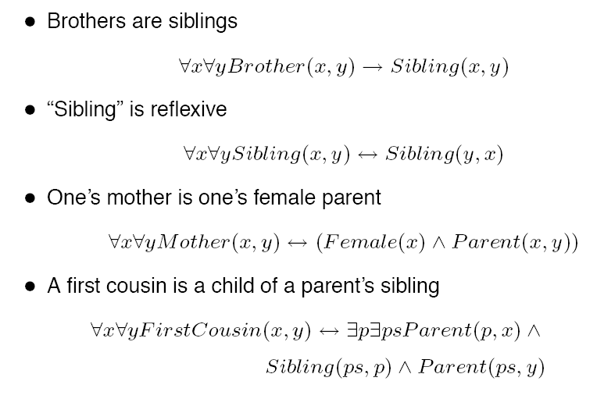
Fun with Sentences
All x is the first cousin of (every cousin) y IFF a parent p with a child x whose a sibling ps has a child y

Slide 74
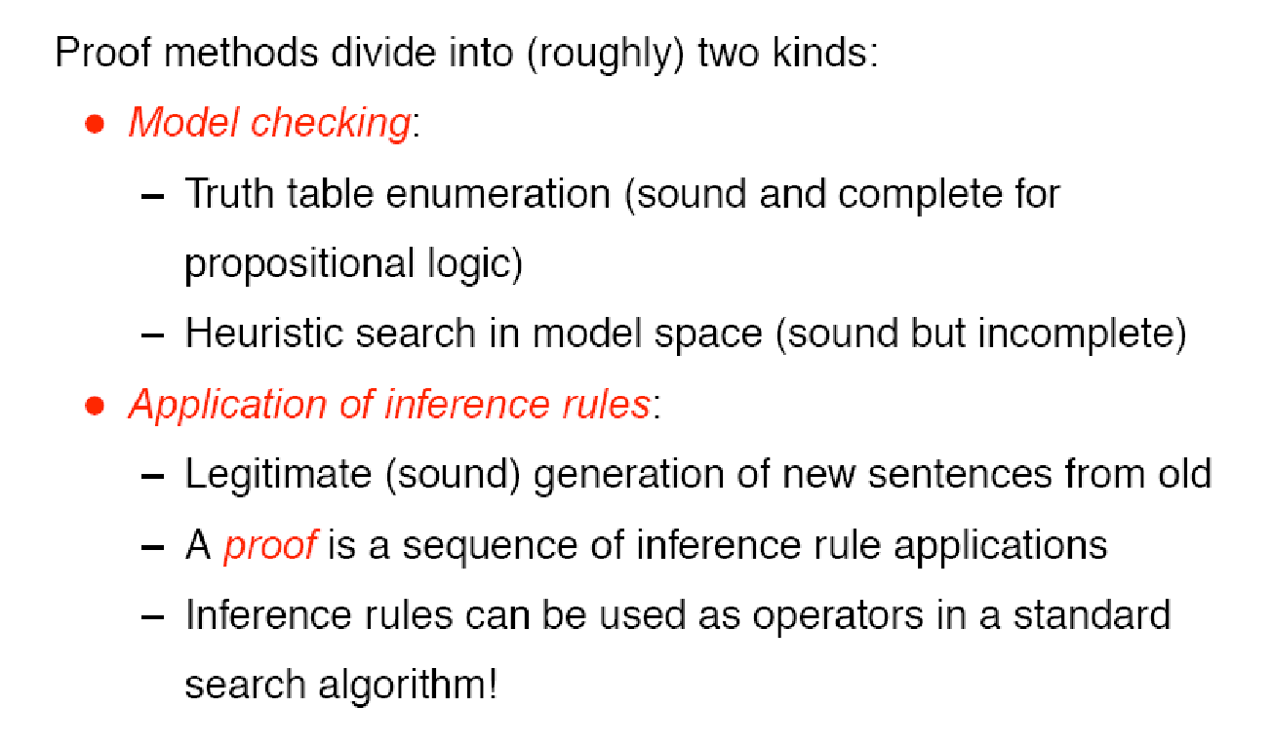
Proof methods

Slide 75
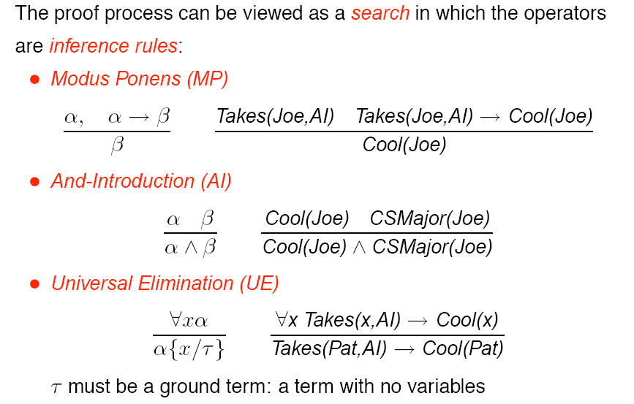
Proofs

Slide 76
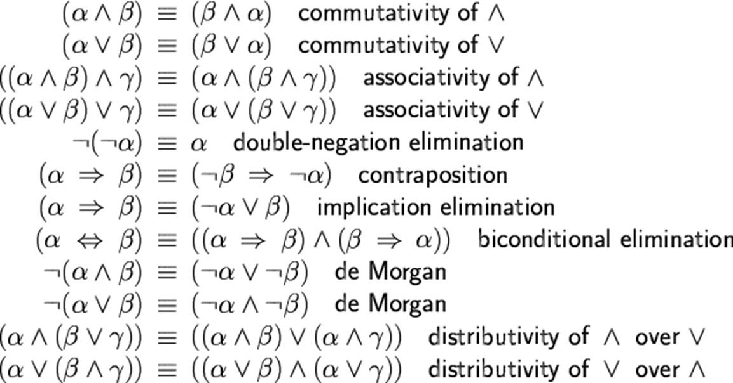
Some inference rules…

Slide 77
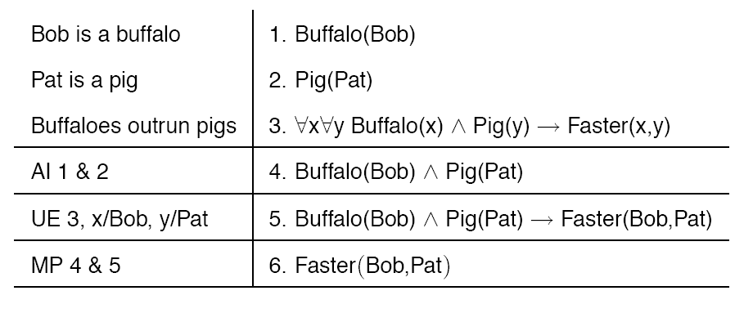
Example Proof

Slide 78
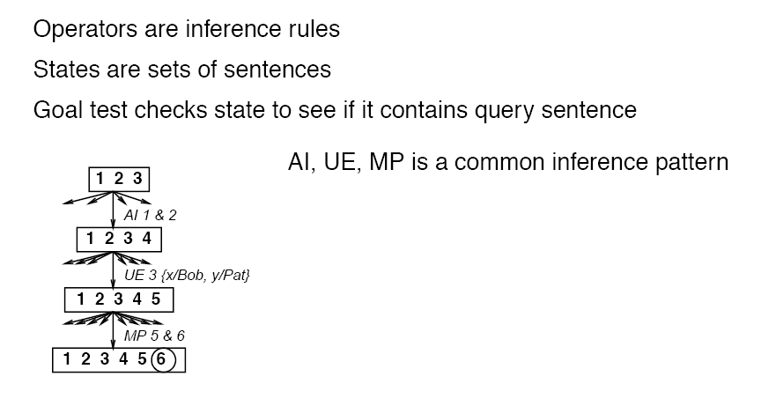
Search with Primitive Inference Rules

Slide 79
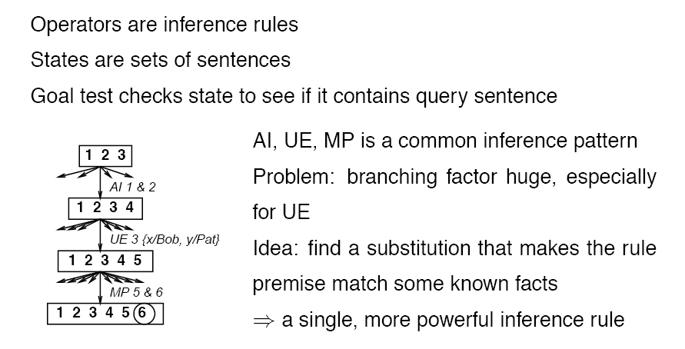
Search with Primitive Inference Rules

Slide 80
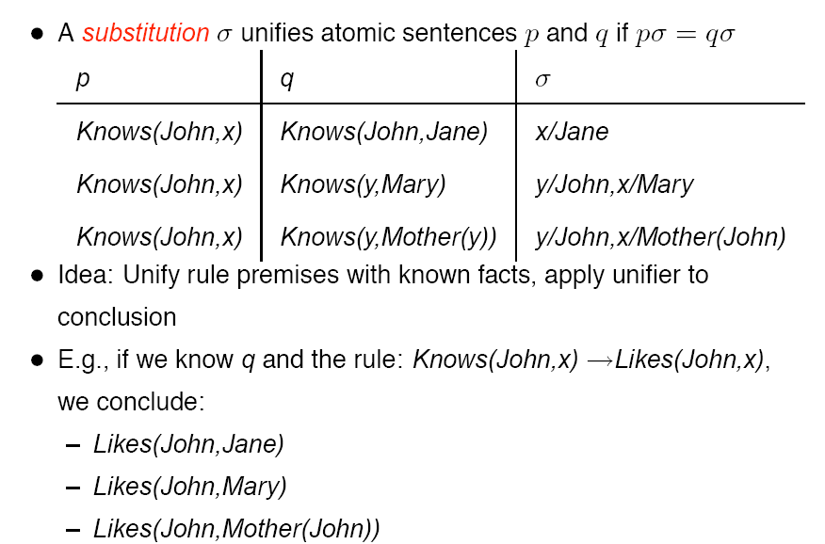
Unification

Slide 81
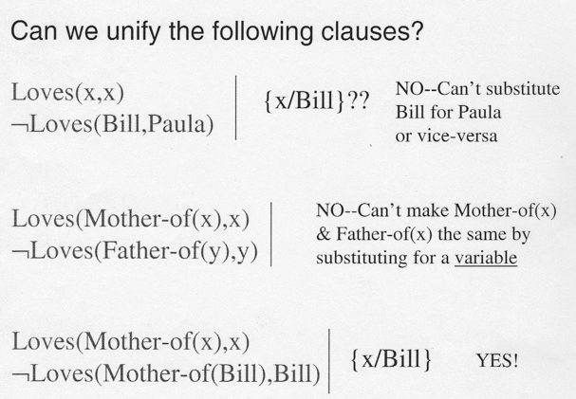
Unification

Slide 82
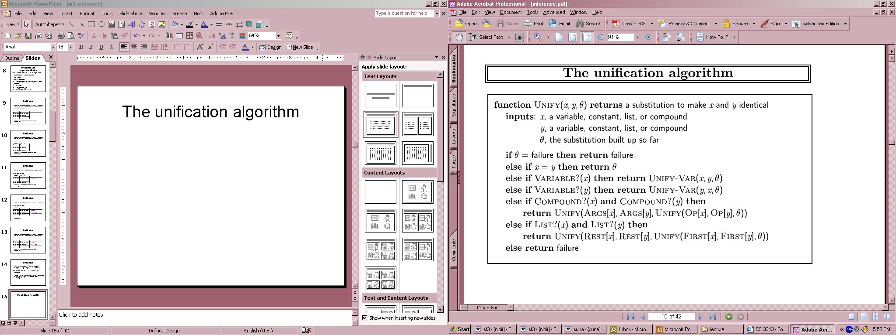
The unification algorithm

Slide 83
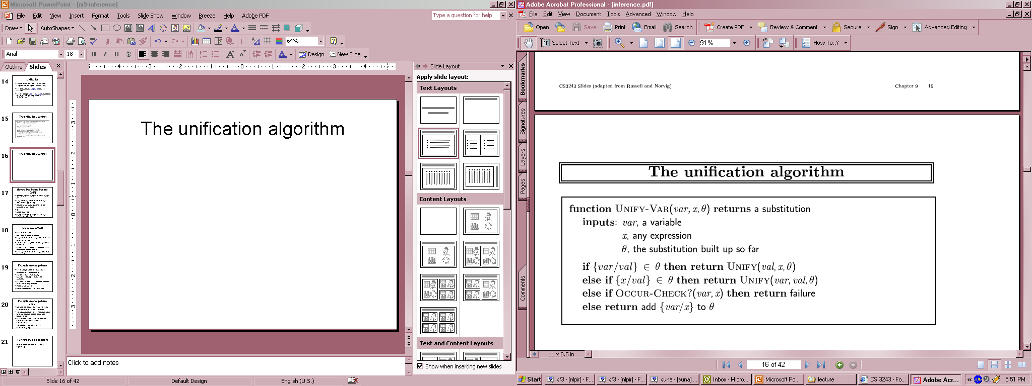
The unification algorithm

Slide 84
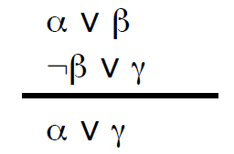
Propositional Resolution
Resolution rule:
Resolution refutation:
Convert all sentences to CNF (conjunctive/clausal normal form)
Negate the desired conclusion (converted to CNF)
Apply resolution rule until either
Derive false (a contradiction)
Can’t apply any more
Resolution refutation is sound and complete
If we derive a contradiction, then the conclusion follows from the axioms
If we can’t apply any more, then the conclusion cannot be proved from the axioms.

Slide 85
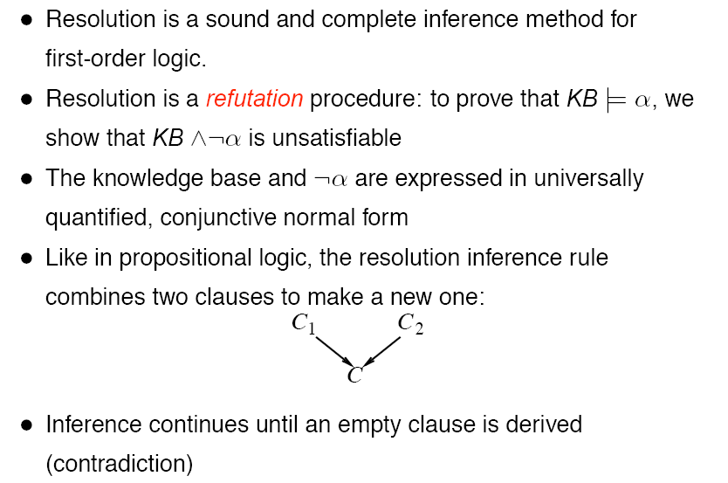
Resolution

Slide 86




Slide 87



Slide 88



There’s no row where all statements are true simultaneously.That means the set is unsatisfiable.

Slide 89

Resolution Proof Tree

Slide 90

Resolution Strategies

Slide 91
In resolution refutation, can we use a clause that have been resolved?
In resolution if we have a set S composed of three clause C1, C2 and C3 and we want to proof that C4 is derivable from S using refutation:
Suppose we've resolved C1 and C2 to C5, can we resolve C1 with C5 or C3 or C4 or C2 cause even it has been resolved?
And if we want to conceive an algorithm for that do we have to delete each resolved couple of clauses from or initial set I= {S, ¬C4} and add the resolvent instead?
And lastly, do we have to use all the clause to derive ⊥ or we stop once we find ⊥ even if we find it in the first step?

Slide 92
Answers
Suppose we've resolved C1 and C2 to C5, can we resolve C1 with C5 or C2?
No, not really. If C1 and C2 can be resolved in more than one way, then all those resolvents are tautologies. And if C1 can be resolved with C5, then it can also be resolved with C2 in a second way (assuming C1 is not a tautology, and hence cannot be resolved with itself).

Slide 93
Answers..
Can we resolve C1 with C3 or C4 cause even it has been resolved?
We can (and often must) resolve C1 with C3, even so it has already been resolved with C2. We don't need to resolve any clause with C4 itself, rather the negation of C4 must be brought into a conjunctive normal form. The clauses of that normal for have to be added to our set S.

Slide 94
Answers ..
And if we want to conceive an algorithm for that do we have to delete each resolved couple of clauses from or initial set I= {S, ¬C4} and add the resolvent instead?
No, that would be too simple. What you actually do is to select a variable that you want to eliminate from the clauses in the set S, and then:
for every clause C containing the variable and every clause N containing the negation of the variable
resolve C and N and add the resolvent to the set S
remove all original clauses containing the variable or its negation from the set S

Slide 95
Answers..
And lastly, do we have to use all the clause to derive ⊥ or we stop once we find ⊥ even if we find it in the first step?
We stop once we find ⊥.

Slide 96
Example: Translate the KB into propositional logic
If it is hot and humid, then it is raining. If it is humid, then it is hot. It is humid. Is it Raining?
H It is hot.
D It is humid.
R It is raining.
1. If it is hot and humid, then it is raining
2. If it is humid, then it is hot
3. It is humid

Slide 97

Example: PROOF-Logical Inference Rules
GOAL-Is it Raining?
1. (H ^ D) -> R
2. D -> H
3. D
From 2 and 3: by Modus Ponens, we infer:
4. H
From 4: by AND-introduction, we infer:
5. H ^ D
From 1 and 5: by Modus Ponens, we infer:
6. R (Goal -- It is raining)

Slide 98




Translate the KB into propositional logic
PROOF-Logical Inference Rules

Slide 99
Applications of First-Order Logic
Prolog: a logic programming languages
Production systems
Semantic nets
Automated theorem proving
Planning

Slide 100
Summary
We learned three topics in this chapter: AI knowledge representation, propositional logic and predicate logic.
Knowledge representation is a part of Artificial intelligence which concerned with thinking that contributes to intelligent behavior.
Propositional logic is a branch of mathematical logic which studies the logical relationships between propositions (or statements, sentences, assertions) taken as a whole, and connected via logical connectives.
A predicate is an expression of one or more variables defined on some specific domain. A predicate with variables can be made a proposition by either assigning a value to the variable or by quantifying the variable

